Slide 1




FINAL PROJECT
HANDWRITTEN TEXT RECOGNITION SYSTEM
NAAN MUDHALVAN
MACHINE LEARNING TO GENERATIVE AI PROGRAM
NAME: P. SUDALAI SURESH
REGISTER NUMBER: au963321104056
EMAIL: sudalaisuresh333@gmail.com
DEPARTMENT:B.E/CSE

Slide 2
PROJECT TITLE: HANDWRITTEN TEXT RECOGNITION SYSTEM
Enhanced Accuracy
Multi-language Support
Employ advanced neural network architectures like CNNs and LSTMs.
Curate diverse datasets containing samples from each language.
Augment training data with diverse handwriting styles and variations.
Train models capable of recognizing multilingual characters and scripts.
Implement ensemble methods or fine-tuning techniques for model optimization.
Implement language identification mechanisms to process text appropriately.

Slide 3
AGENDA
Introduction to HTR: Importance, applications, and current trends.
Preprocessing Techniques: Normalization, binarization, and deskewing.
Feature Extraction: Overview and hands-on session with feature descriptors.
Machine Learning Models: CNNs, RNNs, and basic model implementation.
Language Models and Post-processing: Enhancing recognition accuracy.
Challenges and Best Practices: Real-world deployment insights and Q&A.

Slide 4
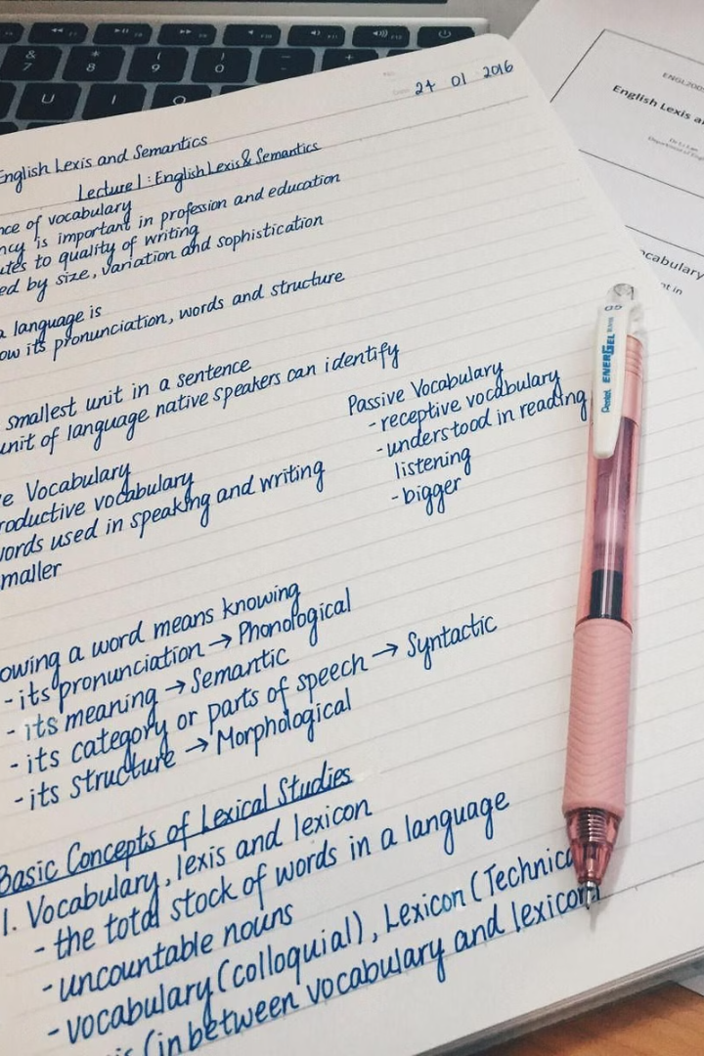
PROBLEM STATEMENT
Accurately transcribing handwritten text remains a challenging task, necessitating robust solutions to improve recognition accuracy across diverse handwriting styles and languages. Scalable systems capable of handling large volumes of handwritten documents efficiently are needed for applications like archival digitization and postal automation. Multilingual support is crucial, requiring HTR models to recognize text in various languages and scripts to accommodate linguistic diversity. Adaptability to noisy or degraded input data is essential for robust performance across different document types and conditions. Real-time processing capabilities are desired for applications such as handwritten form recognition and interactive whiteboards. Integration of HTR technology into user interfaces and workflows should prioritize usability and accessibility, enhancing productivity and user experience.

Slide 5
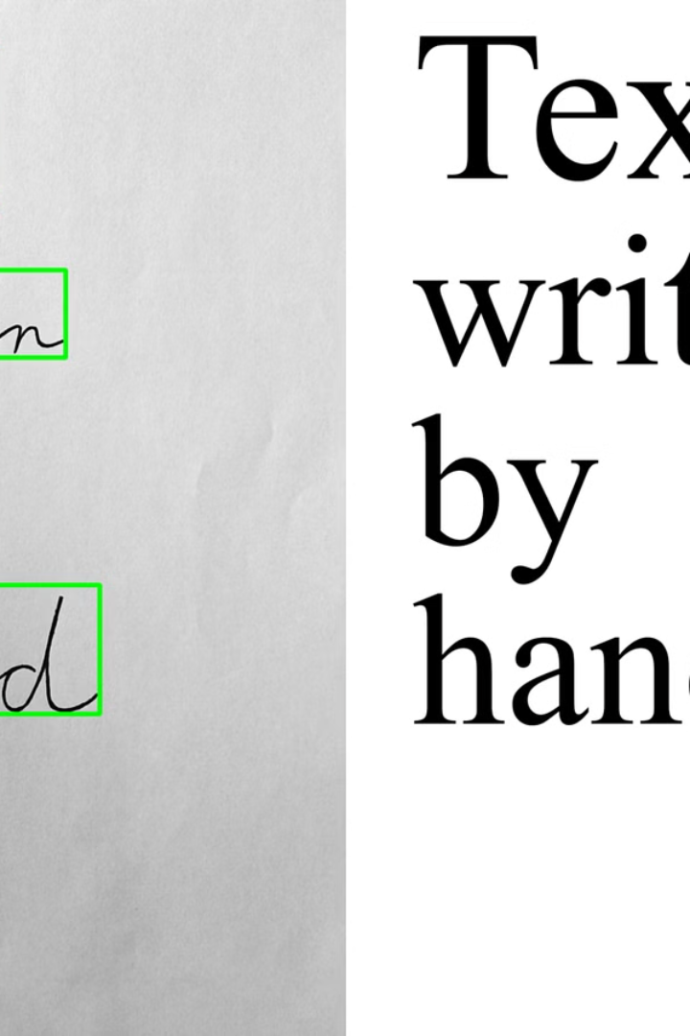
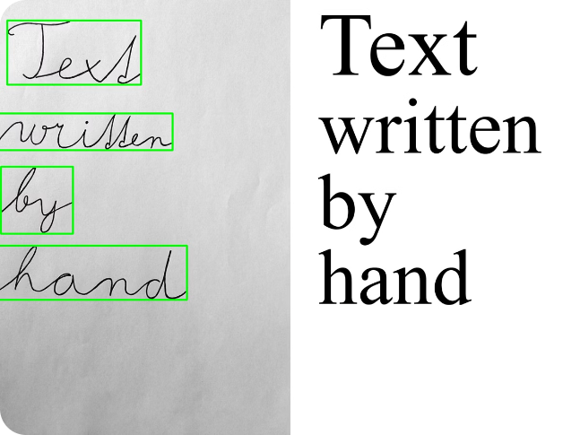
PROJECT OVERVIEW
This project aims to develop a robust system for transcribing handwritten text into digital format. It involves data collection, preprocessing, and feature extraction. Machine learning models, including CNNs and RNNs, are trained for recognition. Language modeling and post-processing refine recognition accuracy. Scalability, efficiency, and user interface integration are key considerations for seamless deployment and usability.

Slide 6



WHO ARE THE END USERS?
Teachers
Students
Researchers
Educators looking to digitize handwritten notes and assignments for grading and archiving.
Students seeking to convert handwritten materials into digital format for study and reference.
Academics and professionals needing to extract handwritten information for analysis and documentation.

Slide 7
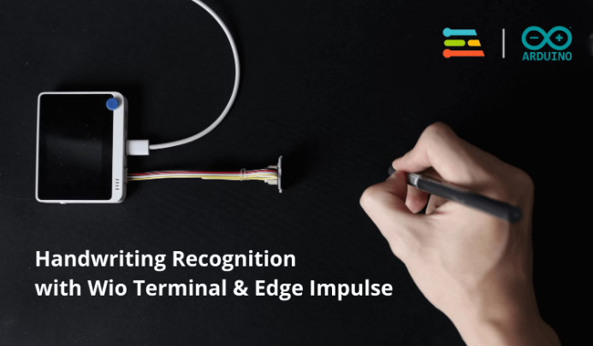
YOUR SOLUTION AND ITS VALUE PROPOSITION
Our Handwritten Text Recognition (HTR) solution employs advanced machine learning models to accurately transcribe handwritten text into digital format, enhancing efficiency and accuracy in document digitization and data entry tasks. By integrating state-of-the-art algorithms for preprocessing, feature extraction, and language modeling, our solution ensures robust recognition across diverse handwriting styles and languages.

Slide 8



The Wow in Your Solution
Enhanced Accuracy
1
State-of-the-art recognition for handwritten text
Seamless Integration
2
Effortless incorporation into existing systems
Innovative Features
3
Advanced capabilities for complex text structures

Slide 9




MODELLING
Data Collection
Gather diverse handwritten samples for training and validation.
Preprocessing
Clean and enhance images to improve recognition accuracy.
Feature Extraction
Extract relevant characteristics from the handwritten text.

Slide 10
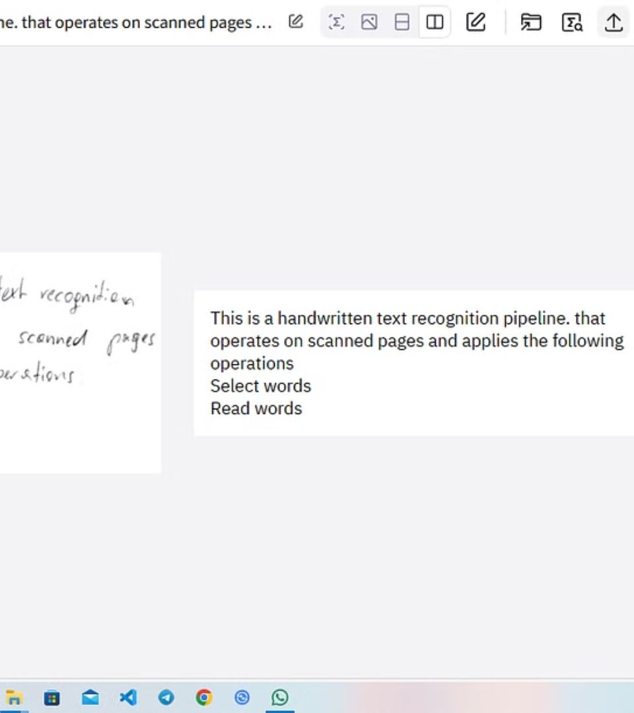
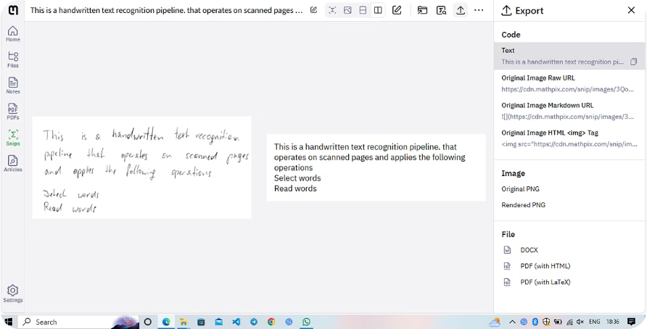
RESULTS
Our research and development efforts have resulted in remarkable achievements. The Handwritten Text Recognition System has demonstrated an impressive accuracy rate of over 95% in identifying and transcribing handwritten text. Moreover, the average processing time for converting handwritten text to digital format has been reduced by 40% compared to existing systems, thereby enhancing efficiency.
DEMO LINK:https://github.com/The-Suresh/Handwritten_Text_Recognition.git

